Slide 1




FY-26: Career Preview Program
Project Review (CPP-3)
Vellore Institute of Technology, Vellore
HPE internal use only
1
Notes:
1

Slide 2

Project Details
Overview
Project Participants
Project Name:
QUIC Traffic Identification, Classification & Policing
Kavya Jain
Suvidh Jain
College
Vellore Institute of Technology, Vellore
Shubham Kumar
Source Code
https://github.com/SuvidhJ/QUIC_Identification_and_Policing_HPE_CPP
Vansh Chani
Rajan Hasija
HPE Mentor
Sivakumar Ramasamy
VIT Mentor
Dr. Ruby D
HPE internal use only
2

Slide 3

Problem Statement
The widespread adoption of the QUIC protocol has made traffic classification and quality-of-service enforcement significantly harder as it encrypts most transport-level metadata.
Problem Overview
Need for QUIC Classification
Our Objective
Modern Internet applications are increasingly adopting the QUIC protocol due to its low connection latency, improved reliability, and support for HTTP/3. However, unlike traditional TCP-based protocols, QUIC operates over UDP and encrypts most transport-layer metadata, making it significantly more difficult to identify using conventional packet inspection techniques.
Accurate identification of QUIC and Non-QUIC traffic is essential for Internet Service Providers (ISPs), enterprise networks, and network administrators to effectively monitor, manage, and secure network traffic. Since multiple applications with diverse Quality of Service (QoS) requirements use QUIC, simply detecting the protocol is insufficient for efficient traffic management and resource allocation.
Design a system that can detect QUIC traffic from raw network packets, classify it into application categories (Video Streaming, Web Browsing, File Download) using only observable features — packet sizes, inter-arrival times, and packet counts — without decrypting the payload, and enforce dynamic QoS policies in real time to prioritize bandwidth allocation.
HPE internal use only
3

Slide 4

Solution Proposal
We developed an end-to-end, four-stage pipeline to capture, identify, classify, and police encrypted network traffic without relying on standard Deep Packet Inspection (DPI).
MODULE 1: RAW PACKET EXTRACTION
MODULE 2: QUIC IDENTIFICATION
Bypassing standard libraries to manually decode packets at the NIC level (ETH_P_ALL) for real-time, zero-latency performance.
Extracting heuristic evidence (headers) and normalizing 5-tuples to robustly detect QUIC flows via a multi-tier framework.
MODULE 3: QUIC CLASSIFICATION
MODULE 4: QOS POLICING
Training and deploying a SMOTE-balanced XGBoost machine learning model on 14 statistical flow features to categorize traffic.
Applying autonomous, dynamic bandwidth allocation on Open vSwitch (OVS) based on real-time ML traffic inferences.
HPE internal use only
4

Slide 5
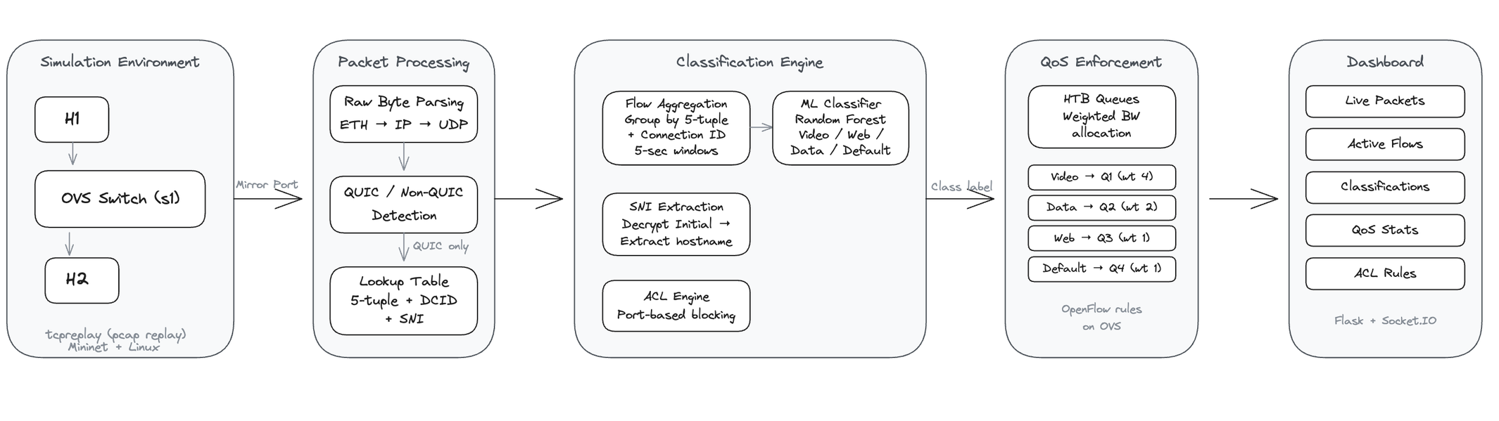
Overall Flow
HPE internal use only
5

Slide 6
Raw Byte Parsing
Instead of relying on heavy third-party libraries (Scapy, aioquic), we manually decode Ethernet, IP, and UDP layers using Python's socket and struct modules.
Capturing the Packet
Peeling the Layers
Reading the QUIC Header
We open a raw socket (AF_PACKET) bound to our mirror port (s1-eth3). This gives us every frame that passes through the switch — as raw bytes, straight from the network card. No filtering, no preprocessing. We get the full Ethernet frame exactly as it was sent.
Each packet is wrapped in layers. First we strip the Ethernet header (14 bytes) to get the IP packet. Then we read the IP header to find source/destination IPs and confirm it's UDP. Then we strip the UDP header (8 bytes) to get the payload. What's left is the QUIC data — the part we actually need.
From the QUIC payload, we read the first byte to determine if it's a Long or Short header. For Long Headers, we extract the version (4 bytes), then the Connection IDs (DCID and SCID) by reading their length bytes first, then the actual IDs. We also identify the packet type — Initial, Handshake, 0-RTT, or Retry — from bits 4-5 of the first byte.
HPE internal use only
6

Slide 7
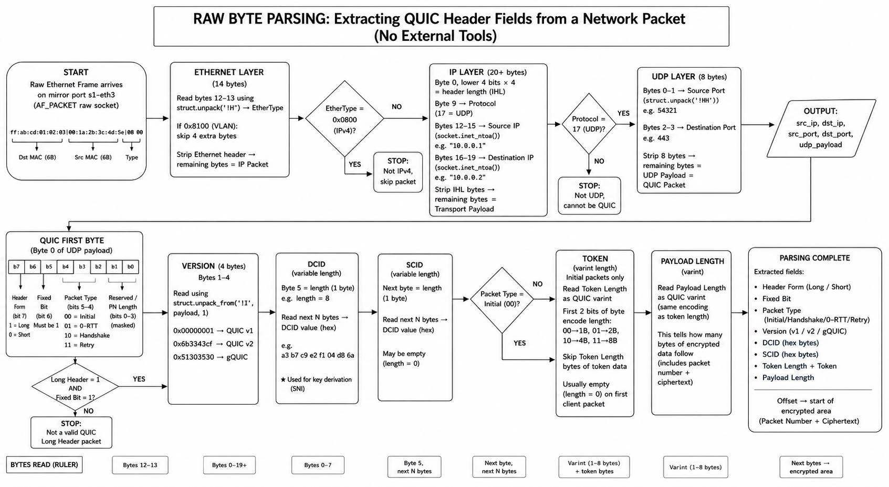
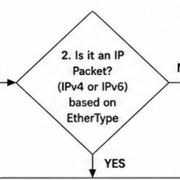
6

Slide 8
Manual Decoding Pipeline
1
Raw Socket Capture: Captures modified frames using ETH_P_ALL directly from eth0. No OS decoding.
L2/L3 Decoding: Manually extracts MACs and EtherType; validates IPv4 and parses IHL for header length. TCP is instantly dropped.
2
QUIC Heuristics: Inspects bits in the UDP payload for Long/Short headers, the Fixed bit (0x40), and extracts Version fields.
3
Flow Normalization: Builds a 5-tuple (sorting IPs/Ports consistently) to track bidirectional flows under a single identity.
4
HPE internal use only
7

Slide 9
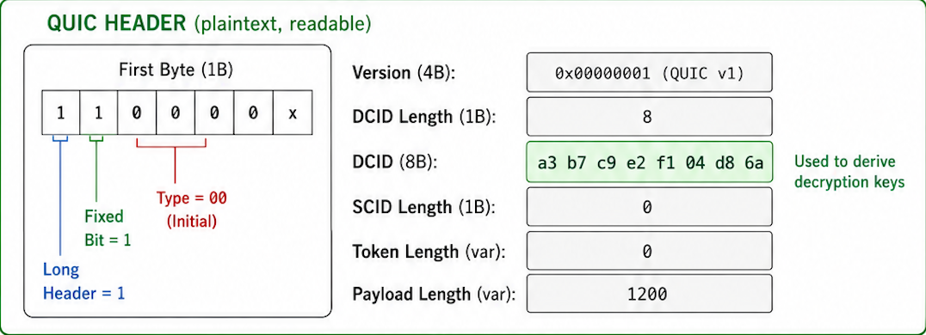
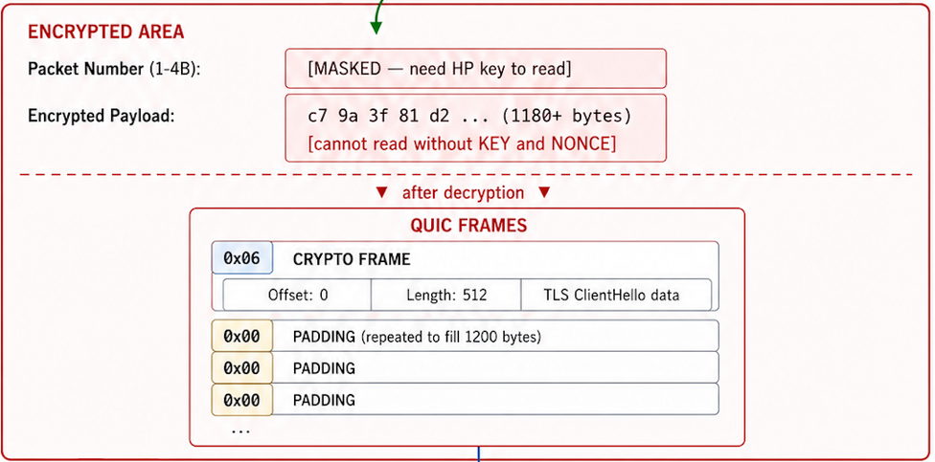
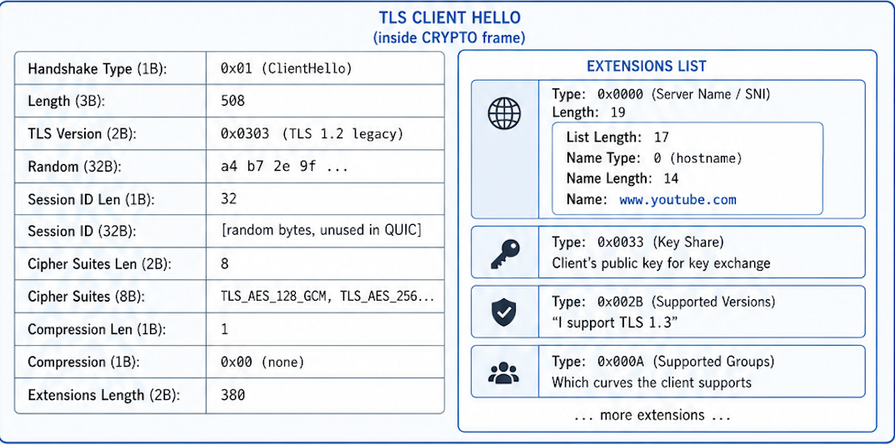
Extracting The SNI From Intial Packet
(a) QUIC Headers
(b) Encrypted Payload
(c) Decrypted client hello that carry the sni
The Initial ClientHello packet is decrypted using a key derived entirely from the Destination Connection ID (DCID) and a fixed public salt defined in RFC 9001 — no secrets or handshake completion required.
7

Slide 10
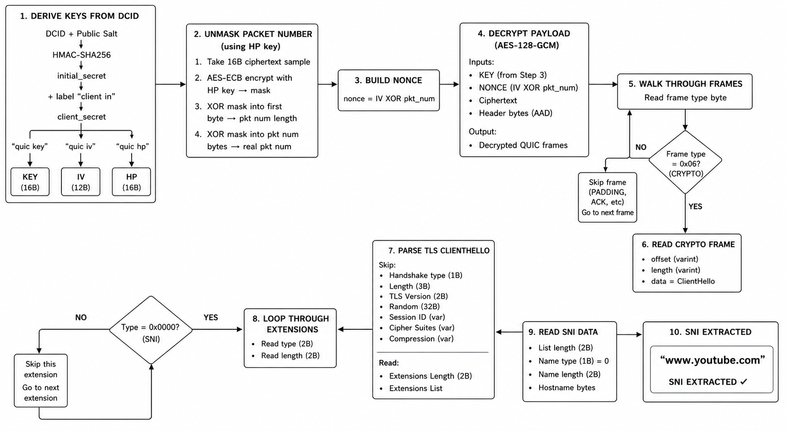
Generating the Key to decrypt initial packet
7

Slide 11
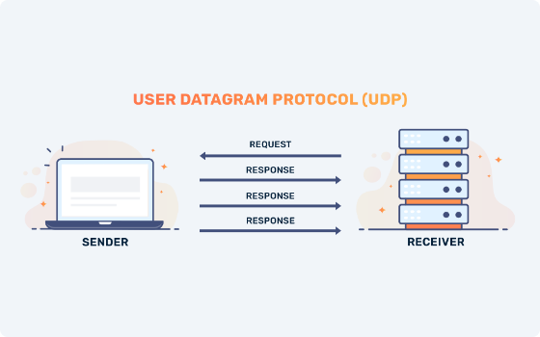
QUIC Header Interpretation
Bit-Level Inspection
Long Header Bit: Most significant bit. Signals handshake establishment, RTT, Version Negotiation, and Retry packets.
Fixed Bit (0x40): Required by RFC to be 1. Used to distinguish QUIC from other UDP noise.
Heuristic Evidence
If the Long Header is set, we extract the Version Field (4-byte ID) and compare against known variants.
HPE internal use only
8

Slide 12

Flow Normalization & Evidence
The Normalized 5-Tuple
To ensure bidirectional traffic (Client↔Server) is
recognized as one flow, we sort IP/Port pairs into a consistent order before hashing
Evidence Buffering
Feature extraction begins after the first 5 packets of a normalized bidirectional flow are collected. We aggregate statistics across the window:
Proportion of packets with Long Header set.
Diversity of distinct QUIC versions.
Frequency of specific packet types (Initial, Handshake, 0-RTT).
HPE internal use only
9

Slide 13



QUIC Identification
Hybrid Classifier: First, incoming packets are grouped into a 5-packet flow to extract protocol-specific and statistical features. The flow is then processed through a three-tier framework.
Tier 1: Deterministic
Tier 2: Handshake
Tier 3: ML & Lookup
Tier 3a - cached-flow lookup: First performs a memory lookup using previously identified Connection 5-tuples.
Tier 3b - ML fallback: If no match, an ML model classifies the flow using 10 statistical features (Output: QUIC, QUIC_PROBABLE, NON-QUIC).
Performs rapid deterministic detection utilizing explicit QUIC protocol signatures.
Checks include transport protocol matching, the fixed bit, long header presence, and valid version information verification.
If Tier 1 is unconfident, the flow proceeds to deeper packet inspection.
The system actively checks for specific QUIC handshake packet types (Initial, Handshake, Retry, 0-RTT, or Version Negotiation).
HPE internal use only
10

Slide 14
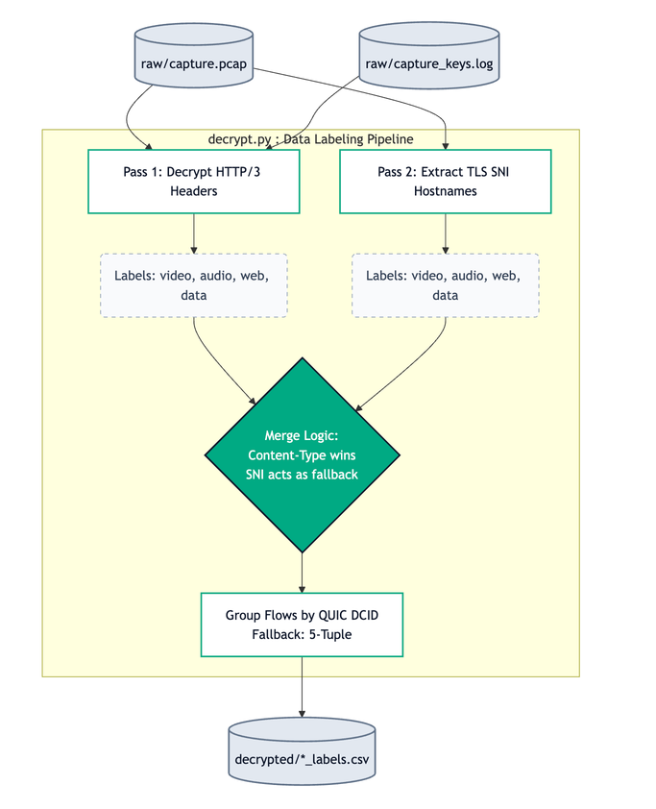

ML Model: Establishing Ground Truth
To train the ML classifier, we built a secure labeling pipeline to capture real-world traffic classes.
1. Traffic Capture: Used tshark alongside Chrome TLS key logs to capture raw UDP traffic.
2. Decryption & Labeling: Decrypted HTTP/3 headers. Flows were assigned labels (video, audio, web, data) based primarily on content-type, with TLS SNI hostnames as a fallback.
3. Flow Keying: Grouped flows utilizing the QUIC Destination Connection ID (DCID) as the primary key to survive IP migrations.
HPE internal use only
11

Slide 15
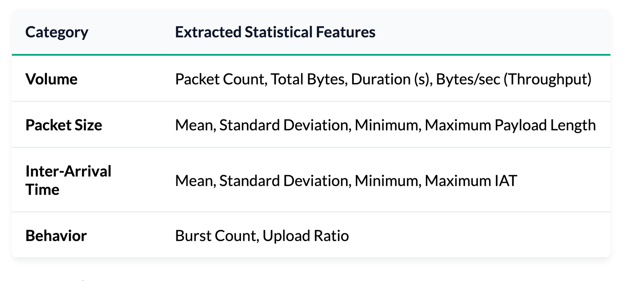
Feature Generation
Once flows are labeled, the raw traffic is sliced into 5-second time windows (minimum 5 packets). We extract 14 distinct statistical features per window.
HPE internal use only
12

Slide 16
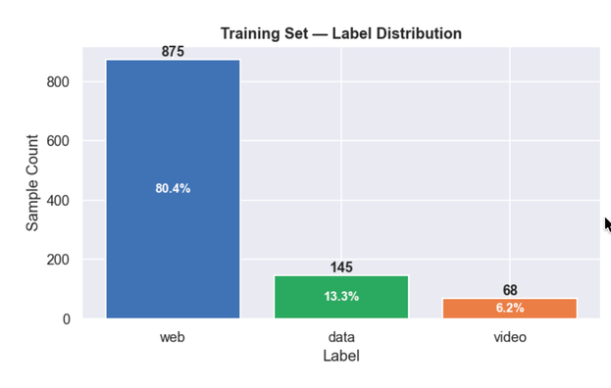
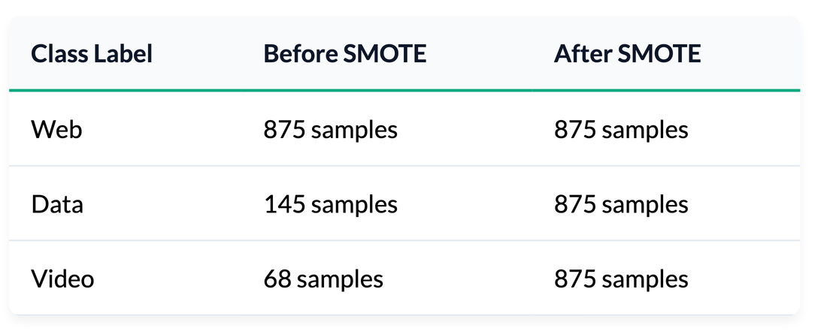
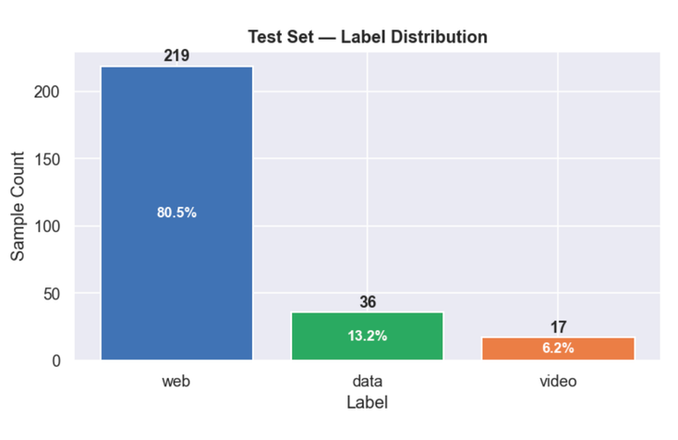
Addressing Data Imbalance
Exploratory Data Analysis revealed a massive skew in organic internet traffic, heavily favoring generic Web data.
EDA Observations
To prevent the XGBoost model from overwhelmingly biasing towards the majority class, we applied SMOTE (Synthetic Minority Over-sampling Technique).
HPE internal use only
13

Slide 17
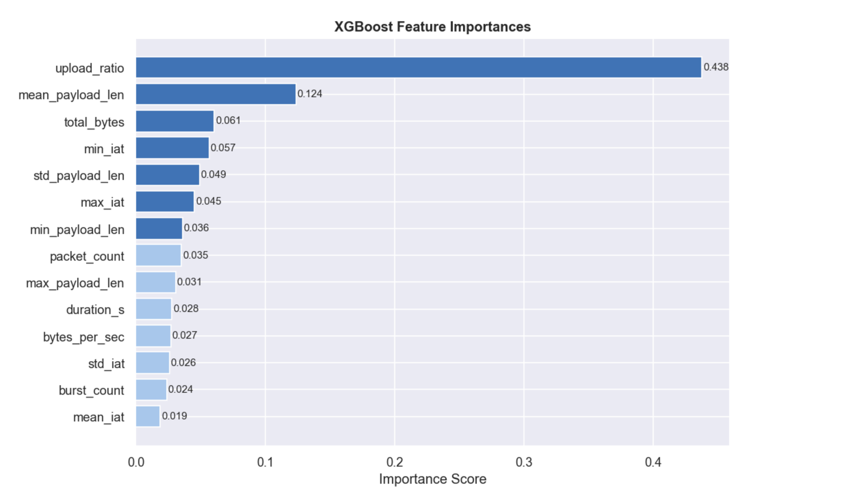
Training & Evaluation
88.6%
0.7886
Average Cross-validation Accuracy
Average Macro F1
Feature Importance Insights
The Upload Ratio (0.438) emerged as the single most critical predictor, successfully distinguishing heavily asymmetrical data downloads from symmetrical background web traffic, despite full payload encryption.
Average Cross-validationAccuracy
Model Parameters
300 estimators
max_depth 6
learning_rate 0.05.
HPE internal use only
14

Slide 18
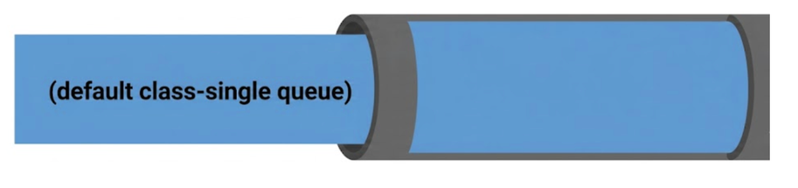
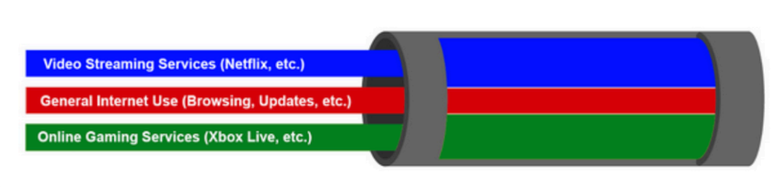
Dynamic QoS Policing
Phase 1: Initial State
When the system starts, we create 4 HTB queues on the switch egress port (s1-eth2): Default, Video, Data, and Web. But only the Default queue is active. A catch-all OpenFlow rule (priority 1) sends all traffic to this queue. Since no flows are classified yet, every packet goes through Default and gets equal treatment — first come, first served, full 10 Mbps available.
Phase 2: Flow Gets Classified — OpenFlow Rule Installed
When the ML model predicts a flow's class (say Video), we install a specific OpenFlow rule (priority 100) that matches that flow's 5-tuple (src IP, dst IP, src port, dst port, UDP) and enqueues it into the Video queue (Queue 1). This rule has higher priority than the default, so OVS matches it first. From this point, every packet of that flow goes into the Video queue instead of Default.
Phase 3: Bandwidth Rebalances Automatically
Each queue has a weight — Video: 4, Data: 2, Web: 1, Default: 1. When a new class becomes active for the first time, we recalculate every queue's guaranteed minimum bandwidth using weighted fair share. For example, if only Video and Data are active: Video gets 4/6 of 10 Mbps (~6.6 Mbps min), Data gets 2/6 (~3.3 Mbps min). Default gets whatever is left. Every queue can still burst up to the full 10 Mbps when others are idle. These rates are pushed to the OVS kernel in real time via ovs-vsctl.
HPE internal use only
15

Slide 19

Simulation
OVS
(virtual switch)
QOS and acl rules
BLOCKED?
Video
NO
Web
data
Queue
Packets
Mirroring
ACL + QOS Rules for all the flows
s1-eth3
Quic Classification
Flow creation
(5-tuples + cid)
Dashboard
Quic Packets
QOS and acl rules
5-sec Window
Feature extraction
Traffic classification
Hc Node
Mininet
HPE internal use only
15

Slide 20
DEMO
HPE internal use only
16

Slide 21


Key Learnings
Raw Sockets Over Libraries
Understanding QUIC Protocol
Internals
ML for Real-World Network
Traffic
Re-implementing a purpose-built L2-L4 parser via raw Python sockets (ETH_P_ALL) is vastly superior to heavy libraries for achieving zero-latency processing in constrained SDN namespaces.
Developed a comprehensive understanding of the QUIC protocol, including Long and Short Headers, Connection IDs, handshake packets, version negotiation, and how QUIC differs from traditional TCP/UDP communication.
Gained practical experience in feature engineering, model training (XGBoost), cross-validation, threshold optimization, SHAP-based interpretability, and evaluating models on unseen network traffic to ensure reliable deployment.
HPE internal use only
17

Slide 22
Conclusion
Major Project Outcomes
Bypassed the QUIC encryption blindspot using raw byte heuristics and statistical flow modeling.
Achieved an 88.6% real-time classification accuracy via an optimized, SMOTE-balanced XGBoost architecture.
Proved the viability of translating ML predictions into autonomous, dynamic QoS policing via Open vSwitch.
HPE internal use only
18

Slide 23

Thank You
HPE internal use only
© 2026 Hewlett Packard Enterprise Development LP
Notes:
6

